Slide 1

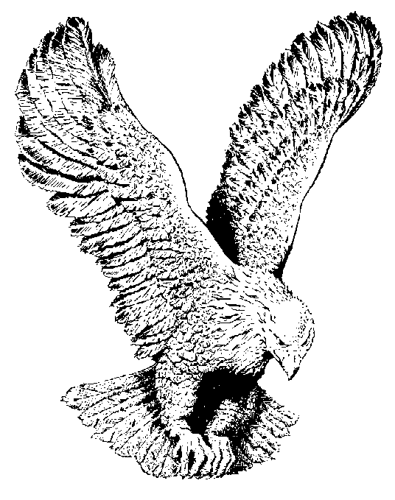
930 HE COULD HAVE CALLED
They bound the hands of Jesus,
In the garden where He prayed,
They led Him thro' the street in shame
They split upon the Saviour, so pure and free from sin
They said crucify Him He's to blame

Slide 2
CHORUS
He could have called ten thousand angels
To destroy the world and set him free
He could have called ten thousand angels
But He died alone, (alone) for you and me (for you and me).

Slide 3
Upon His precious head, they placed a crown of thorns
They laughed and said "behold the king"
They struck him and cursed Him and Mocked His Holy name,
All alone, He suffered everything.

Slide 4
When they nailed Him unto the cross his mother stood near by,
He said, woman, "behold thy son"
He cried "I thirst for water",
But they gave Him none to drink,
Then the sinful work of man was done.

Slide 5
To the howling mob He yielded,
He did not for mercy cry,
The cross of shame He touch alone,
And when He cried "It is finished"
He gave Himself to die,
Salvation wondrous plans was done.

